Slide 1
Hydro: A Hybrid Routing Protocol for Low-Power and Lossy Networks
Stephen Dawson-Haggerty, Arsalan Tavakoli, and David Culler
The University of California Berkeley

Slide 2
Low Power and Lossy Networks
Diversity of applications: customer premise (into the home, “HANs”), neighborhood networks (ie, smart meters, “NANs”)
Smart appliances, programmable lighting controllers & thermostats, building automation
United by common link properties: slow, low-power, lossy
802.15.4e/g, PLC
IPv6 as a unifying framework
6lowpan/ROLL working groups

Slide 3
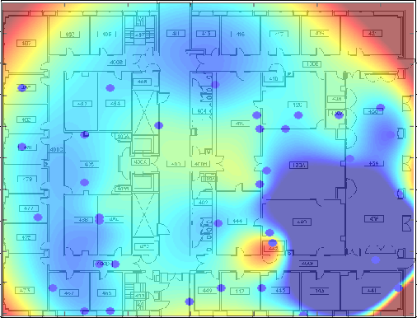
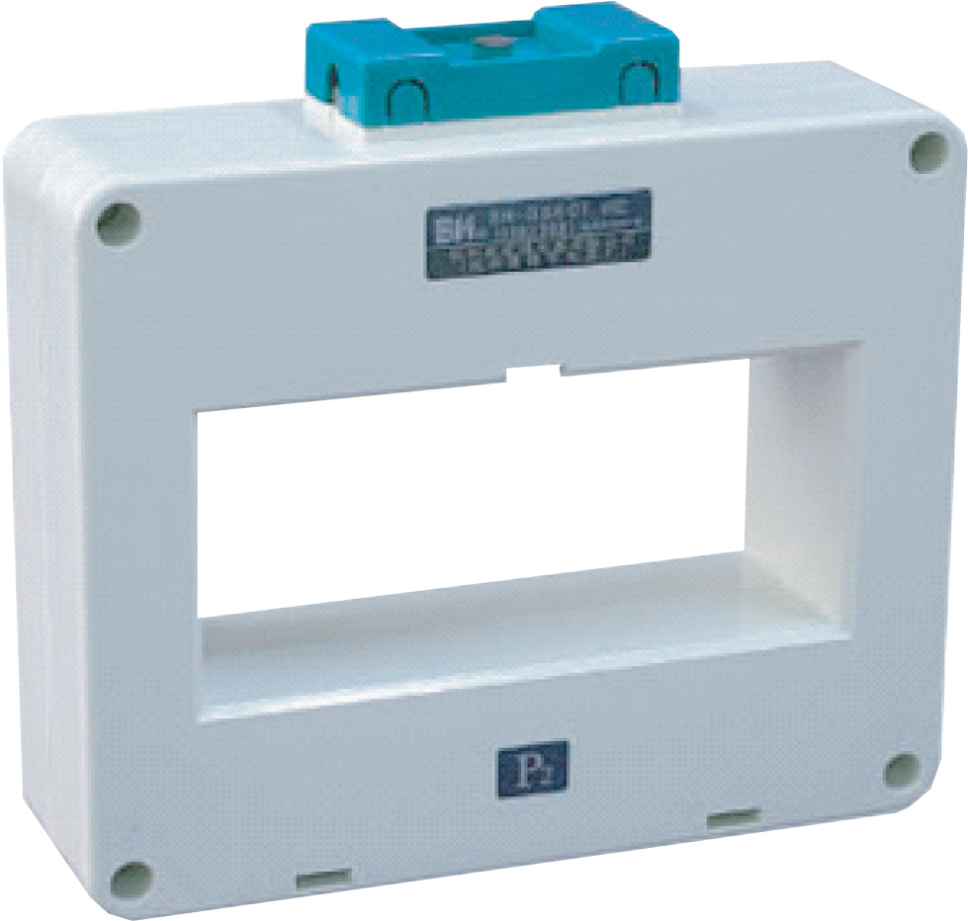
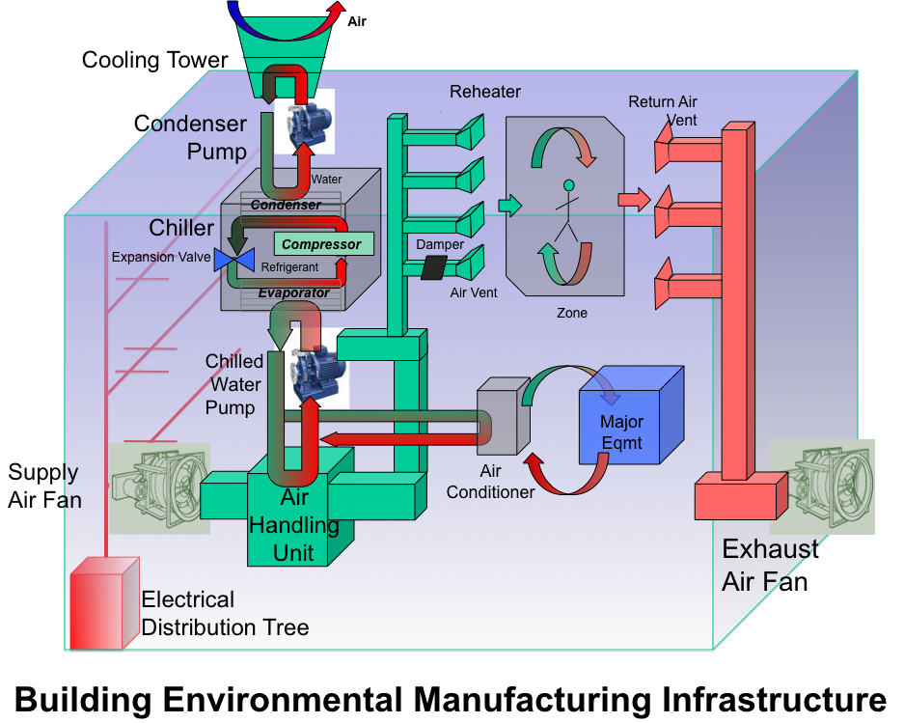
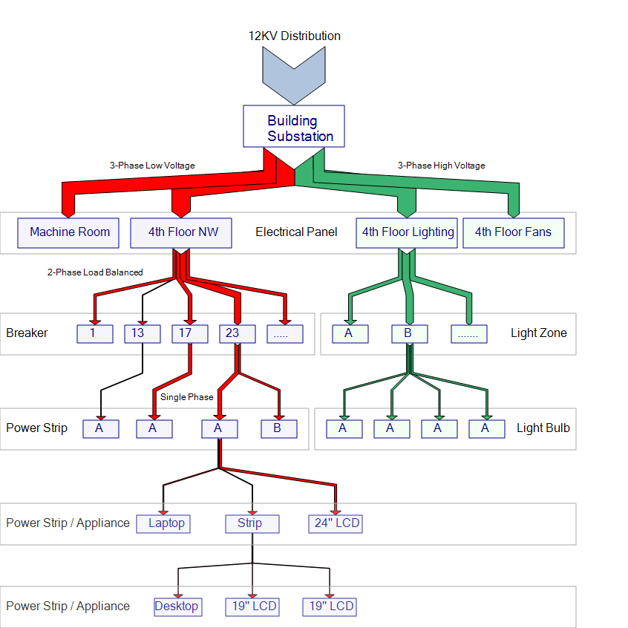
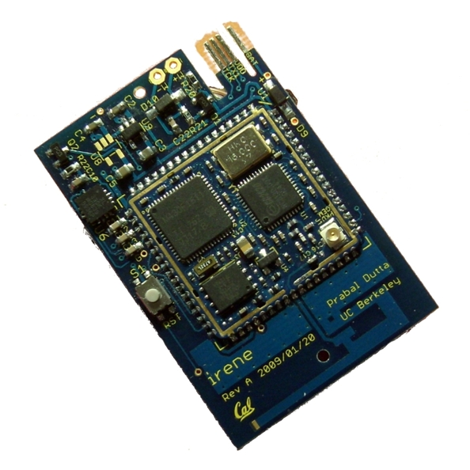
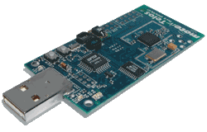
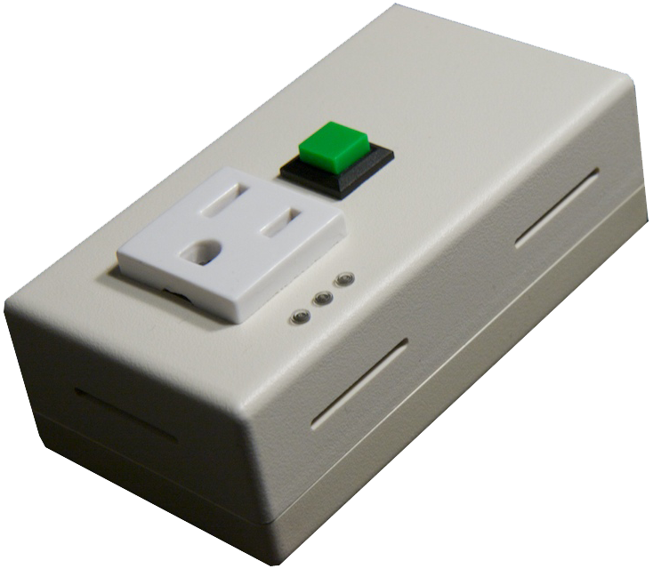
Building Information
Operations and Environment
3
Climate Plant
Load Tree
CT: mains power monitoring
panel level power monitoring
Vibration
Humidity
Temperature
Pressure
ACme: plug load energy monitor and controller

Slide 4
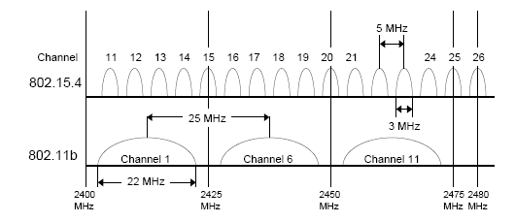
The Routing Problem
Spatial and temporal variation in link quality
Limited resources bound state
48KB ROM, 10KB RAM
Radio communication expensive
Long-lived deployments require extensive duty-cycling

Slide 5
IETF
6lowpan
Adaptation layer for IPv6: 802.15.4 links
ROLL: Routing over Lossy and Low-Power Links
Routing

Slide 6
Can we quantify that?
Metric
Requirement
Table Scalability
# of Destinations
Loss Response
Limited to Active Path
Control Cost
Bounded by Data Rate
Link Cost
Link Dynamicity
Node Cost
Node Heterogeneity

Slide 7
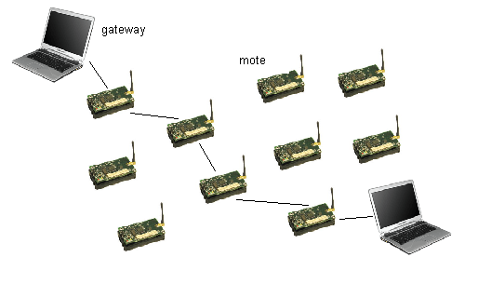
What do we really need?
Workload
Network Topology
Collection (MP2P) Traffic
Border Router
Node
Point-to-Point Traffic
Resource-Starved
More Capable Devices

Slide 8
Our Solution: HYDRO
Two Components:
Distributed DAG for underlying connectivity
Centralized Controllers for Point-to-Point Optimization

Slide 9
Our Solution: HYDRO
Trickle timers for DAG construction
recognize local inconsistencies and quickly repair them
when network is stable, control traffic peters out
Source routing for routes not along a DAG
increased packet overhead
loop freedom
Centralized topology view
allows point-to-point and anycast optimizations

Slide 10
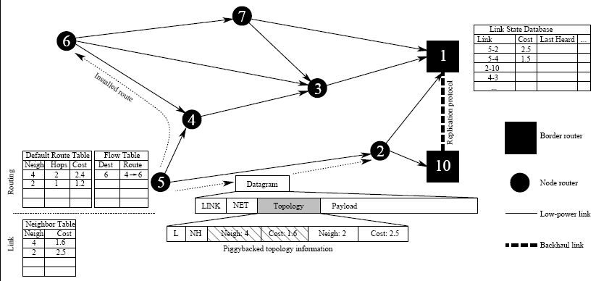
Our Solution: HYDRO

Slide 11
Distributed DAG Formation
Router Advertisement
Route Cost
Willingness
1
3
2
4
6
5
Default Route Table (Node 7)
Neigh | Route | Link | LQI | Conf
2 | 1.2 | MAX | 90 | 0
4 | 2.5 | MAX | 100 | 0
5 | 2.6 | MAX | 100 | 0
7

Slide 12
Distributed DAG Formation
1
3
2
4
6
5
Default Route Table (Node 7)
Neigh | Route | Link | LQI | Conf
2 | 1.2 | 1 | 90 | 1
4 | 2.5 | MAX | 100 | 0
5 | 2.6 | MAX | 100 | 0
7

Slide 13
Distributed DAG Formation
1
3
2
4
6
5
Default Route Table (Node 7)
Neigh | Route | Link | LQI | Conf
2 | 1.2 | 2 | 90 | 7
4 | 2.5 | 1.1 | 100 | 3
5 | 2.6 | MAX | 100 | 0
7

Slide 14
Distributed DAG Formation
1
3
2
4
6
5
Default Route Table (Node 7)
Neigh | Route | Link | LQI | Conf
2 | 1.2 | 2 | 90 | 7
4 | 2.5 | 1.3 | 100 | 5
5 | 2.6 | 1.4 | 100 | 5
7

Slide 15
Global Topology Formation
1
3
2
4
6
5
Default Route Table (Node 7)
Neigh | Cost
2 | 2
4 | 1.3
5 | 1.4
Neigh | Route | Link | LQI | Conf
2 | 1.2 | 2 | 90 | 7
4 | 2.5 | 1.3 | 100 | 5
5 | 2.6 | 1.4 | 100 | 5
7

Slide 16
Centralized Routing
D:7
[2 7]
RI [4 1 6]
D:6
[3 6]
DATA
1
3
2
4
6
5
D:6
DATA
Default Route Table (Node 7)
D:6
[4 1 6]
DATA
7
Neigh | Route | Link | LQI | Conf
2 | 1.2 | 2 | 90 | 7
4 | 2.5 | 1.3 | 100 | 5
5 | 2.6 | 1.4 | 100 | 5
Flow Table (Node 7)
Dest | Flow Path
6 | [4 1 6]

Slide 17
Centralized Routing
D:7
[2 7]
RI [5 1 6]
D:6
[3 6]
DATA
1
3
2
4
6
5
D:6
[F4 1 6]
DATA
Default Route Table (Node 7)
D:6
[4 1 6]
DATA
7
Neigh | Route | Link | LQI | Conf
2 | 1.2 | 2 | 90 | 7
4 | 2.5 | 1.3 | 100 | 5
5 | 2.6 | 1.4 | 100 | 5
Flow Table (Node 7)
Dest | Flow Path
6 | [4 1 6]

Slide 18
Centralized Routing
1
3
2
4
6
5
Default Route Table (Node 7)
Flow Table (Node 7)
7
Neigh | Route | Link | LQI | Conf
2 | 1.2 | 2 | 90 | 7
4 | 2.5 | 1.3 | 100 | 5
5 | 2.6 | 1.4 | 100 | 5
Dest | Flow Path
6 | [5 1 6]

Slide 19
Outline
HYDRO
Design Overview
Evaluation
Limitations
Extensions / Discussion

Slide 20
Evaluation Concerns and Metrics
Concern
How to Evaluate?
Reliability
Packet Delivery Ratio
Convergence
Global Topology View Progression
Stretch
Transmission Stretch
Agility/Stability
Performance Under Node Churn
Scalability
Larger Networks

Slide 21

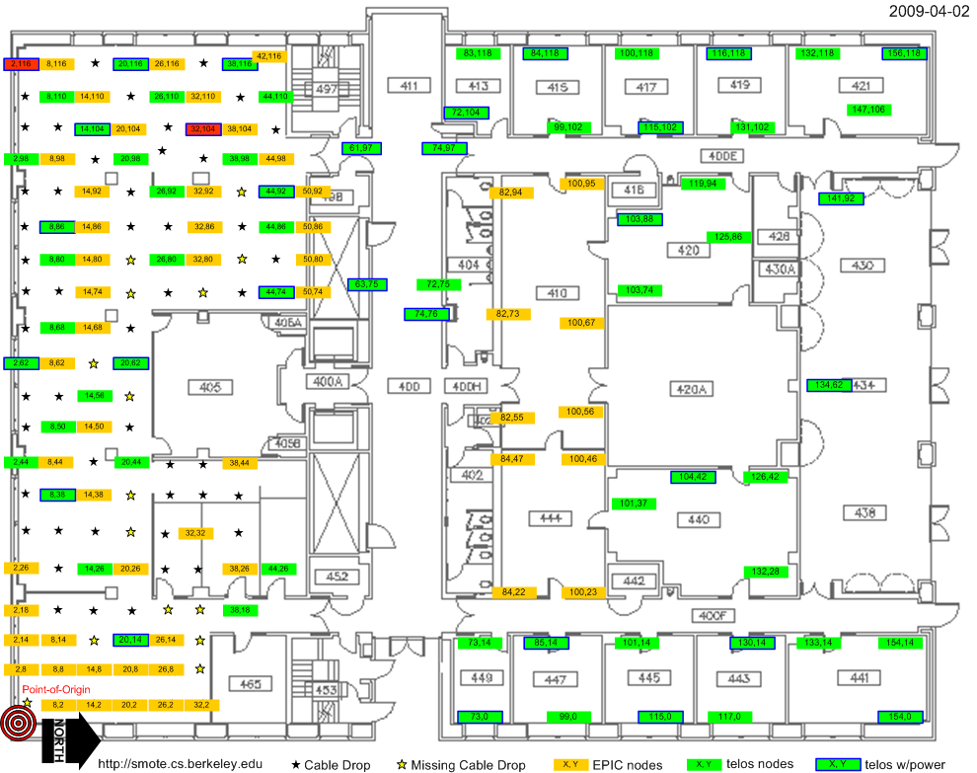
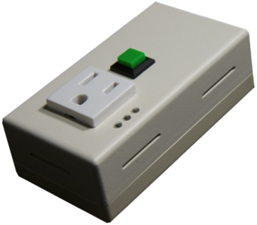

Test Environments
Name | Size | Diameter
Motescope | 49 | 4
Motelab | 128 | 8
ACME | 57 | 8

Slide 22
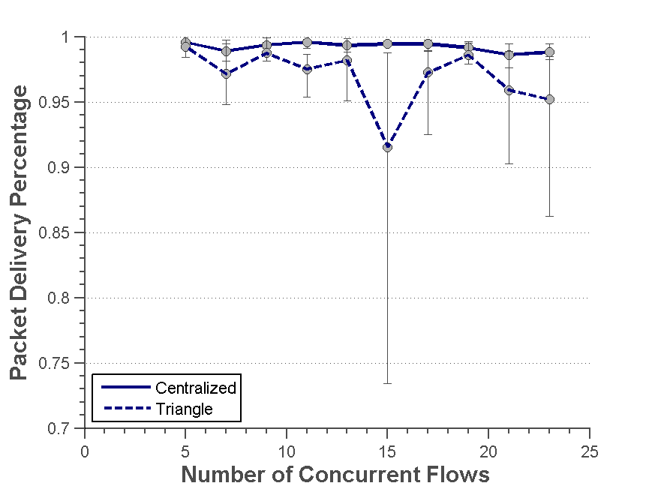
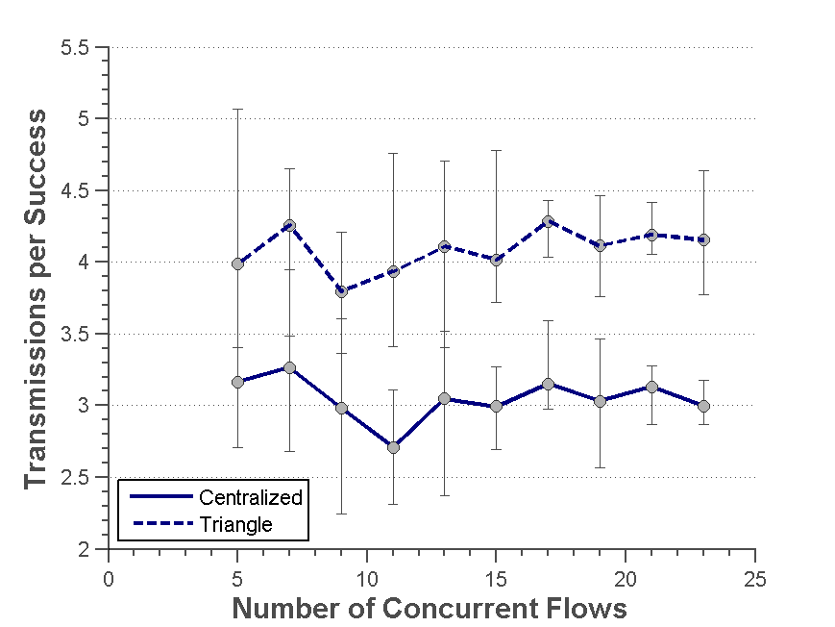
Increased Concurrent Load
Decreases transmissions per success by about 1: ~ 25%
Lower PDR from congestion around Border Router

Slide 23
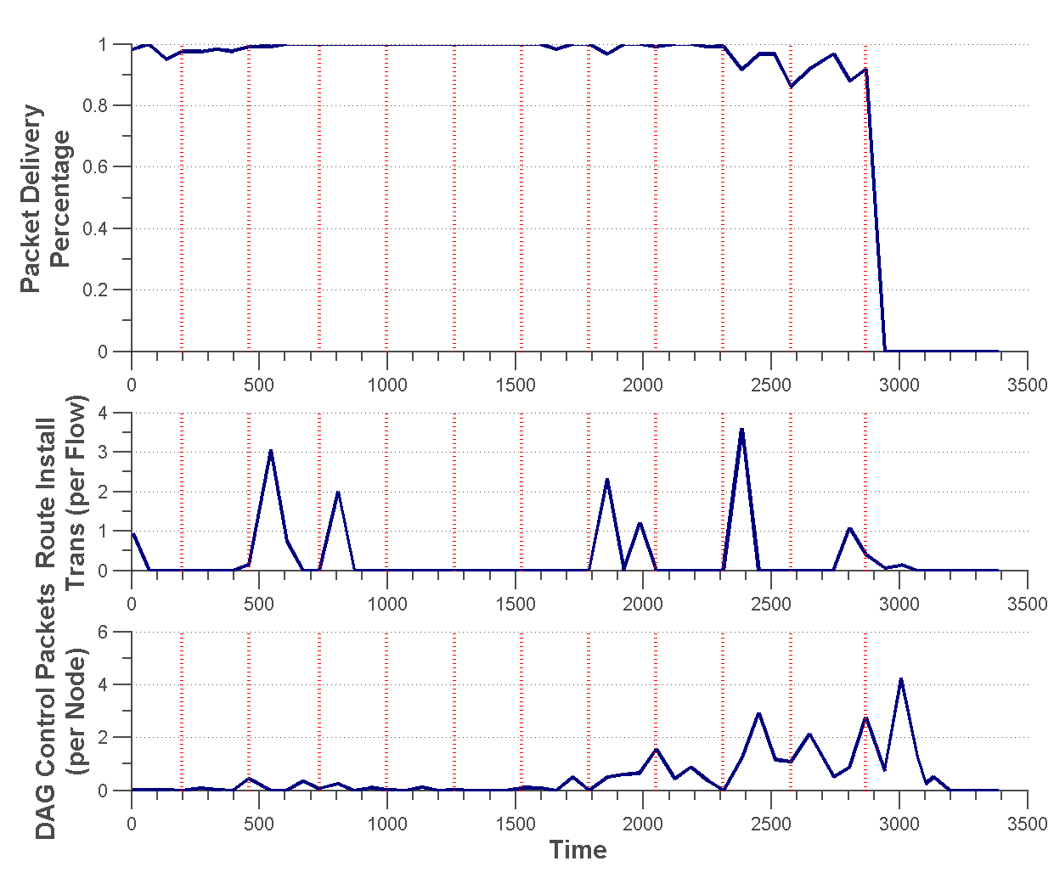
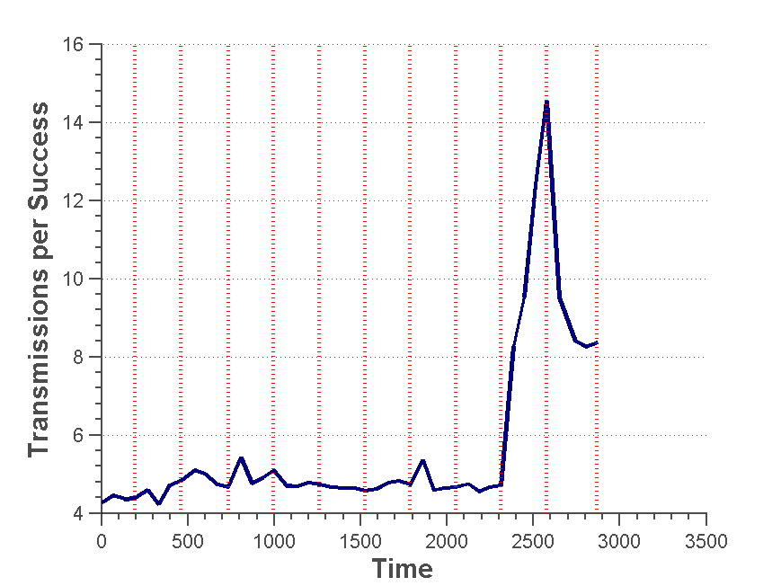
Resilience to Failure
Network becomes partitioned
Failed nodes along default route

Slide 24
IETF Criteria: How do we fare?
Criteria
Requirement
HYDRO
Table Scalability
# Destinations
State for Active Flows
Loss Response
Limit to Active Path
No explicit loss response
Control Cost
Bounded by Data Traffic
Driven by data traffic
Link Cost
Link Quality Awareness
ETX
Node Cost
Heterogeneity
Willingness and Node Attributes

Slide 25
Limitations?
Mobility / Significant Dynamicity
Source Routing and Deep Networks
Single Point of Congestion and Failure

Slide 26
Standards Implications
Early version presented to IETF
Working group: ROLL: Routing over Lossy and Low-Power Networks
Rechartered in 2009 to design new routing protocol
Many design features represented in “final” version
density-sensitive state propagation (trickle timers)
“up and down” routing
dynamic link estimation
Point to point does not include centralized optimization

Slide 27
Questions?

Slide 28
Backup Slides

Slide 29
Centralized Routing
D:6
[3 6]
RI [1 4 7]
DATA
1
3
2
D:7
[1 4 7]
RI [4 1 6]
DATA2
4
6
5
Flow Table (Node 6)
Dest | Flow Path
7 | [1 4 7]
D:6
DATA
Default Route Table (Node 7)
Flow Table (Node 7)
7
Neigh | Route | Link | LQI | Conf
2 | 1.2 | 2 | 90 | 7
4 | 2.5 | 1.3 | 100 | 5
5 | 2.6 | 1.4 | 100 | 5
Dest | Flow Path
6 | [4 1 6]

Slide 30
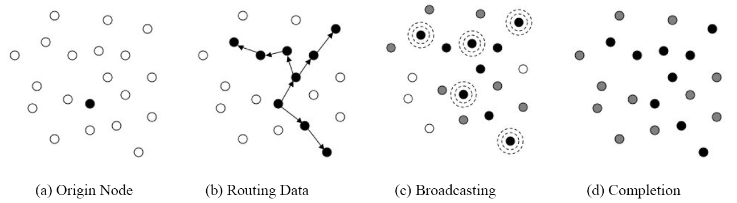
Extensions
Multicast
Hop-By-Hop Route Installs
More Complex Routing Policies
Levis et al. “The firecracker protocol”, ACM SIGOPS European Workshop

Slide 31
State Management
Link State Database
1
3
Default Route Table
?
2
Paths for Active Flows
Paths installed in network
4
6
5
Utilization of installed paths
Utilization of Flow Tables
7

Slide 32
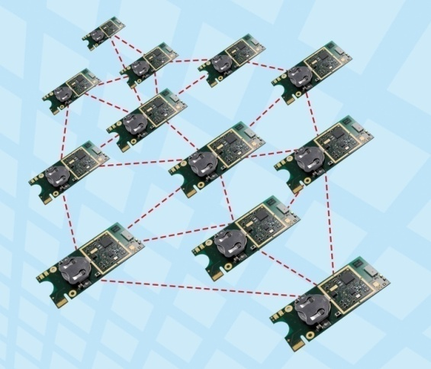
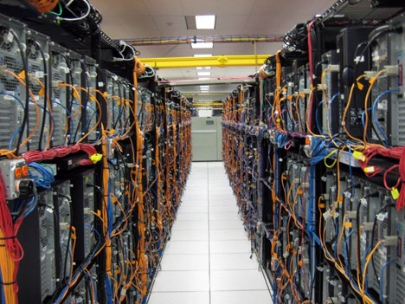
Hypothesis
Hybrid Routing Solution
Centralized Control
Distributed Local Agility
Path-Level Decisions
Link-Level Decisions
Lossy and Low-Power Networks
Data Centers

Slide 33
Existing Solutions??
Collection-Oriented Protocols
Point-to-Point Protocols
MintRoute
MultiHop LQI
BVR
OLSR
CTP
Hui’s IP Architecture
DYMO
S4

Slide 34
Don’t Centralized Solutions Exist?
Existing Solutions
Inherent Assumptions
Routing Control Platform (RCP)
Reliable Path to Centralized Controller
4D
Consistent Global View of Topology
SANE / ETHANE / NOX
Reliable Links

Slide 35
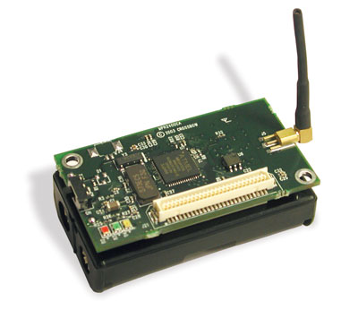
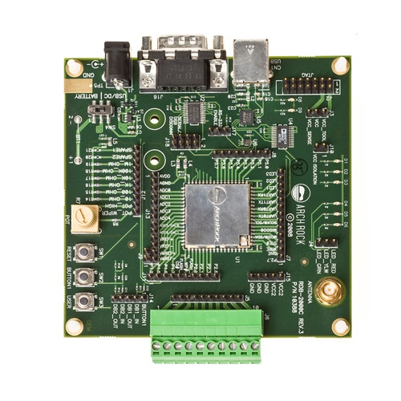
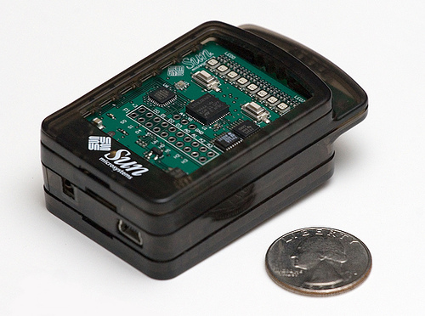

Low-Power and Lossy Networks (L2Ns)
Sensor equipped
Low-bandwidth wireless radio
Constrained resources
Limited energy reserves

Slide 36
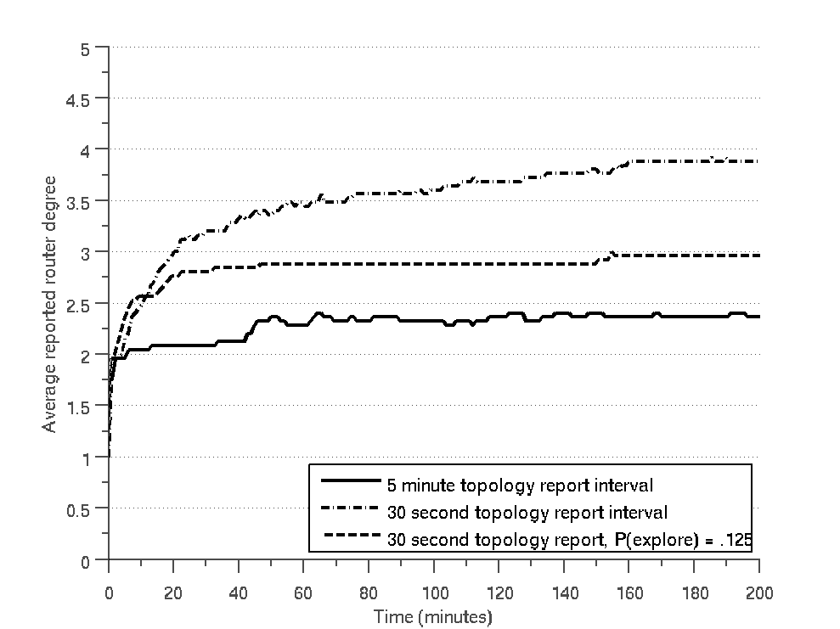
Global Topology Formation
Basic Connectivity achieved quickly

Slide 37
Global Topology Formation
30-Second Interval
5-Minute Interval
Limited improvement in stretch beyond basic connectivity
Longer intervals drastically slow convergence

Slide 38
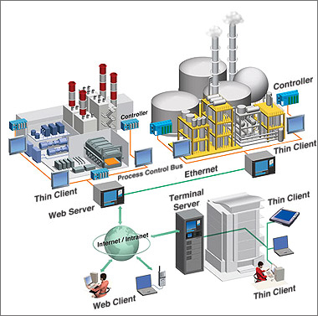
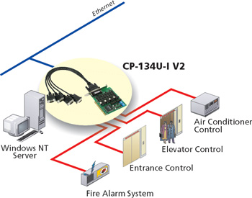
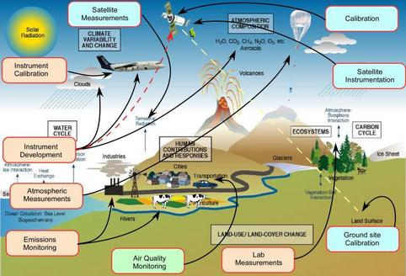
Applications

Slide 39
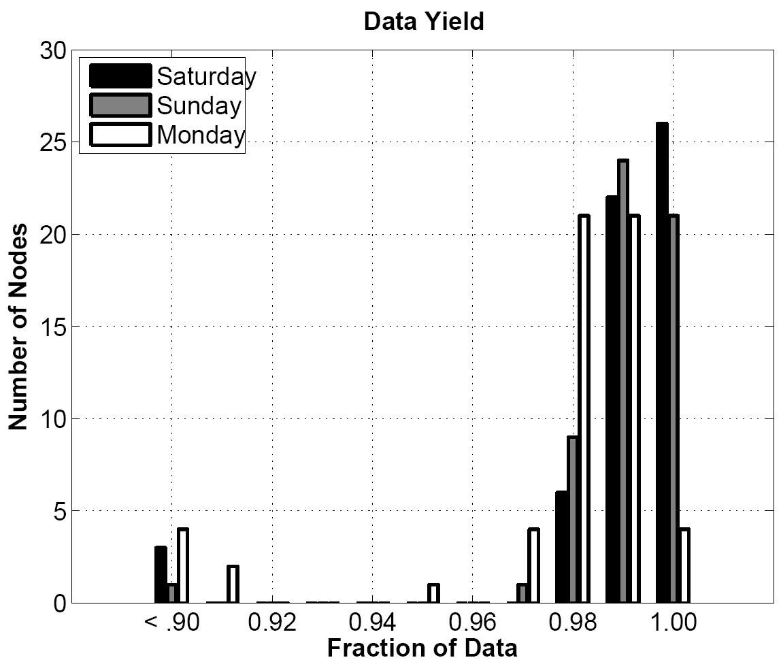
Distributed DAG Formation
Methodology
Real Energy Deployment
57 Nodes
1 report / min
Channel 19

Slide 40
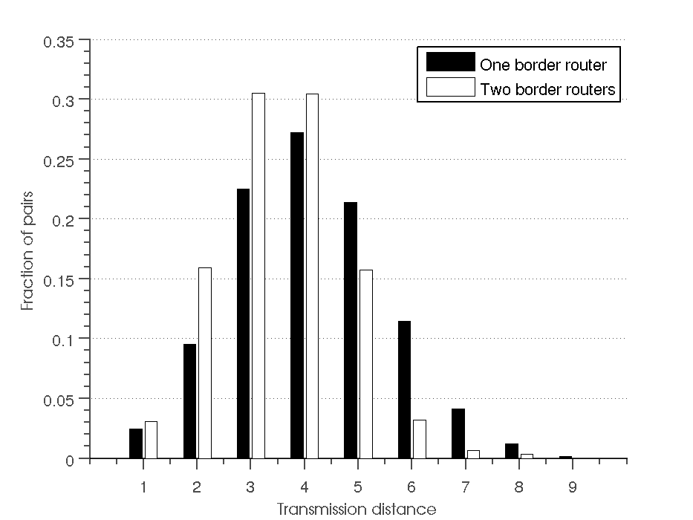
Multiple Border Routers
Second border router helps eliminate long paths

